Slide 1

CHAPTER 5:
PHYSICAL DATABASE DESIGN AND PERFORMANCE
Modern Database Management
11th Edition
Jeffrey A. Hoffer, V. Ramesh,
Heikki Topi
© 2013 Pearson Education, Inc. Publishing as Prentice Hall

Slide 2
OBJECTIVES
Define terms
Describe the physical database design process
Choose storage formats for attributes
Select appropriate file organizations
Describe three types of file organization
Describe indexes and their appropriate use
Translate a database model into efficient structures
Know when and how to use denormalization

Slide 3
PHYSICAL DATABASE DESIGN
Purpose–translate the logical description of data into the technical specifications for storing and retrieving data
Goal–create a design for storing data that will provide adequate performance and ensure database integrity, security, and recoverability

Slide 4
PHYSICAL DESIGN PROCESS
Inputs
Decisions
Normalized relations
Volume estimates
Attribute definitions
Response time expectations
Data security needs
Backup/recovery needs
Integrity expectations
DBMS technology used
Attribute data types
Physical record descriptions (doesn’t always match logical design)
File organizations
Indexes and database architectures
Query optimization
Leads to

Slide 5
PHYSICAL DESIGN FOR REGULATORY COMPLIANCE
Sarbanes- Oxley Act (SOX) – protect investors by improving accuracy and reliability
Committee of Sponsoring Organizations (COSO) of the Treadway Commission
IT Infrastructure Library (ITIL)
Control Objectives for Information and Related Technology (COBIT)
Regulations and standards that impact physical design decisions

Slide 6
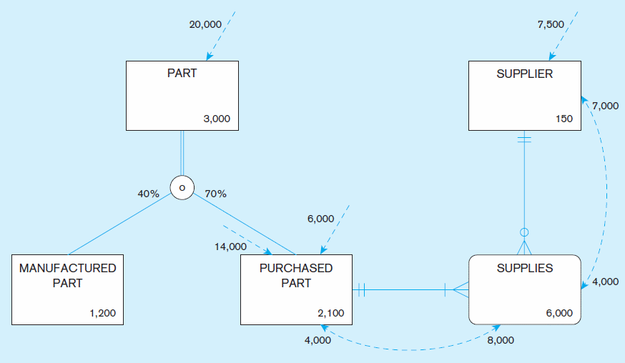
Figure 5-1 Composite usage map
(Pine Valley Furniture Company)
Chapter 5
© 2013 Pearson Education, Inc. Publishing as Prentice Hall

Slide 7
Figure 5-1 Composite usage map
(Pine Valley Furniture Company) (cont.)
Data volumes
Chapter 5
© 2013 Pearson Education, Inc. Publishing as Prentice Hall

Slide 8
Figure 5-1 Composite usage map
(Pine Valley Furniture Company) (cont.)
Access Frequencies (per hour)
Chapter 5
© 2013 Pearson Education, Inc. Publishing as Prentice Hall

Slide 9
Figure 5-1 Composite usage map
(Pine Valley Furniture Company) (cont.)
Usage analysis:
14,000 purchased parts accessed per hour ➔
8000 quotations accessed from these 140 purchased part accesses ➔
7000 suppliers accessed from these 8000 quotation accesses
Chapter 5
© 2013 Pearson Education, Inc. Publishing as Prentice Hall

Slide 10
Figure 5-1 Composite usage map
(Pine Valley Furniture Company) (cont.)
Usage analysis:
7500 suppliers accessed per hour ➔
4000 quotations accessed from these 7500 supplier accesses ➔
4000 purchased parts accessed from these 4000 quotation accesses
Chapter 5
© 2013 Pearson Education, Inc. Publishing as Prentice Hall

Slide 11
DESIGNING FIELDS
Field: smallest unit of application data recognized by system software
Field design
  Choosing data type
  Coding, compression, encryption
  Controlling data integrity

Slide 12
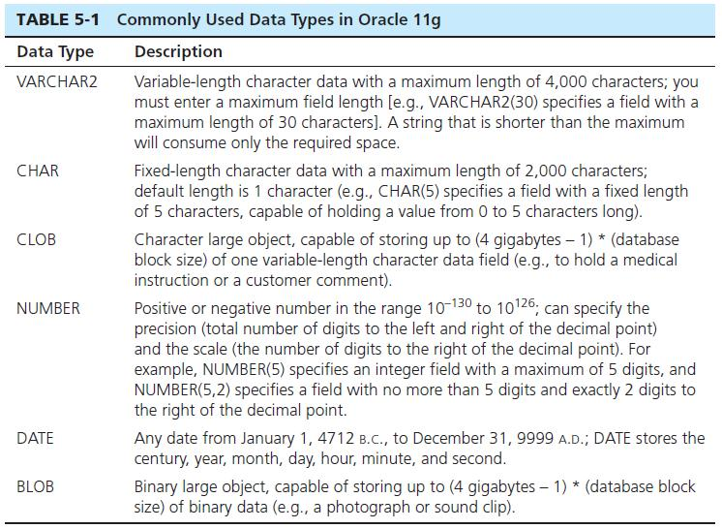
CHOOSING DATA TYPES

Slide 13
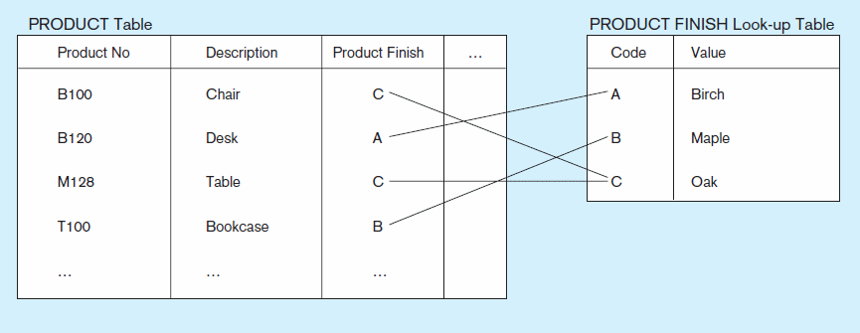
Figure 5-2 Example of a code look-up table
(Pine Valley Furniture Company)
Code saves space, but costs an additional lookup to obtain actual value
Chapter 5
© 2013 Pearson Education, Inc. Publishing as Prentice Hall

Slide 14
FIELD DATA INTEGRITY
Default value–assumed value if no explicit value
Range control–allowable value limitations (constraints or validation rules)
Null value control–allowing or prohibiting empty fields
Referential integrity–range control (and null value allowances) for foreign-key to primary-key match-ups
Sarbanes-Oxley Act (SOX) legislates importance of financial data integrity

Slide 15
HANDLING MISSING DATA
Substitute an estimate of the missing value (e.g., using a formula)
Construct a report listing missing values
In programs, ignore missing data unless the value is significant (sensitivity testing)
Triggers can be used to perform these operations.

Slide 16
DENORMALIZATION
Transforming normalized relations into non-normalized physical record specifications
Benefits:
  Can improve performance (speed) by reducing number of table lookups (i.e. reduce number of necessary join queries)
Costs (due to data duplication)
  Wasted storage space
  Data integrity/consistency threats
Common denormalization opportunities
  One-to-one relationship (Fig. 5-3)
  Many-to-many relationship with non-key attributes (associative entity) (Fig. 5-4)
  Reference data (1:N relationship where 1-side has data not used in any other relationship) (Fig. 5-5)

Slide 17
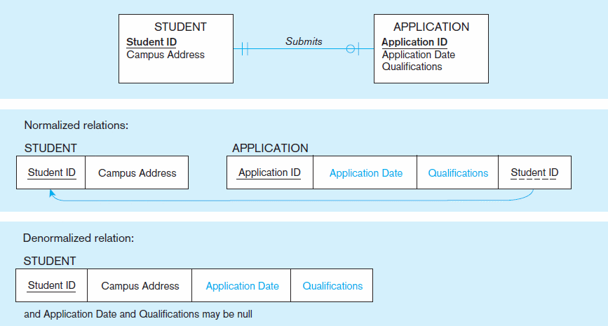
Figure 5-3 A possible denormalization situation: two entities with one-to-one relationship
Chapter 5
© 2013 Pearson Education, Inc. Publishing as Prentice Hall

Slide 18
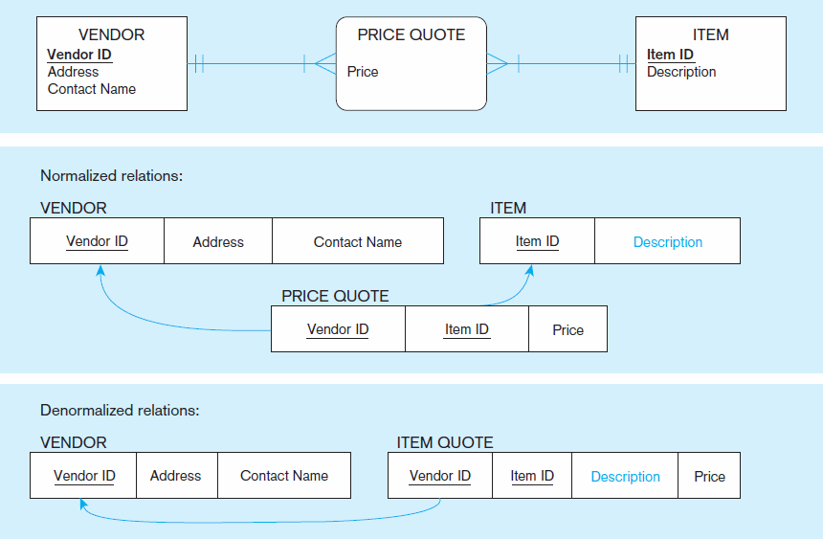
Figure 5-4 A possible denormalization situation: a many-to-many relationship with nonkey attributes
Extra table access required
Null description possible
Chapter 5
© 2013 Pearson Education, Inc. Publishing as Prentice Hall

Slide 19
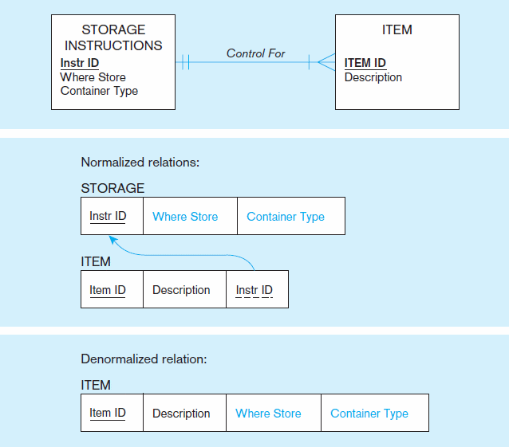
Figure 5-5
A possible denormalization situation:
reference data
Extra table access required
Data duplication
Chapter 5
© 2013 Pearson Education, Inc. Publishing as Prentice Hall

Slide 20
DENORMALIZE WITH CAUTION
Denormalization can
  Increase chance of errors and inconsistencies
  Reintroduce anomalies
  Force reprogramming when business rules change
Perhaps other methods could be used to improve performance of joins
  Organization of tables in the database (file organization and clustering)
  Proper query design and optimization

Slide 21
PARTITIONING
Horizontal Partitioning: Distributing the rows of a logical relation into several separate tables
  Useful for situations where different users need access to different rows
  Three types: Key Range Partitioning, Hash Partitioning, or Composite Partitioning
Vertical Partitioning: Distributing the columns of a logical relation into several separate physical tables
  Useful for situations where different users need access to different columns
  The primary key must be repeated in each file
Combinations of Horizontal and Vertical

Slide 22
PARTITIONING PROS AND CONS
Advantages of Partitioning:
  Efficiency: Records used together are grouped together
  Local optimization: Each partition can be optimized for performance
  Security: data not relevant to users are segregated
  Recovery and uptime: smaller files take less time to back up
  Load balancing: Partitions stored on different disks, reduces contention
Disadvantages of Partitioning:
  Inconsistent access speed: Slow retrievals across partitions
  Complexity: Non-transparent partitioning
  Extra space or update time: Duplicate data; access from multiple partitions

Slide 23
ORACLE’S HORIZONTAL PARTITIONING
Range partitioning
  Partitions defined by range of field values
  Could result in unbalanced distribution of rows
  Like-valued fields share partitions
Hash partitioning
  Partitions defined via hash functions
  Will guarantee balanced distribution of rows
  Partition could contain widely varying valued fields
List partitioning
  Based on predefined lists of values for the partitioning key
Composite partitioning
  Combination of the other approaches

Slide 24
DESIGNING PHYSICAL DATABASE FILES
Physical File:
  A named portion of secondary memory allocated for the purpose of storing physical records
  Tablespace–named logical storage unit in which data from multiple tables/views/objects can be stored
Tablespace components
  Segment – a table, index, or partition
  Extent–contiguous section of disk space
  Data block – smallest unit of storage

Slide 25
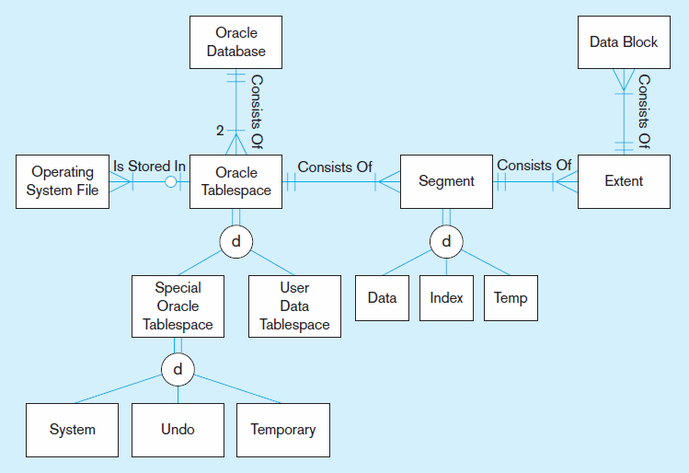
Figure 5-6 DBMS terminology in an Oracle 11g environment
Chapter 5
© 2013 Pearson Education, Inc. Publishing as Prentice Hall

Slide 26
FILE ORGANIZATIONS
Technique for physically arranging records of a file on secondary storage
Factors for selecting file organization:
  Fast data retrieval and throughput
  Efficient storage space utilization
  Protection from failure and data loss
  Minimizing need for reorganization
  Accommodating growth
  Security from unauthorized use
Types of file organizations
  Sequential
  Indexed
  Hashed

Slide 27
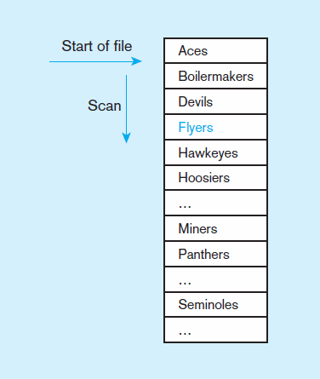
Figure 5-7a Sequential file organization
Records of the file are stored in sequence by the primary key field values.
If sorted – every insert or delete requires resort
If not sorted
Average time to find desired record = n/2
Chapter 5
© 2013 Pearson Education, Inc. Publishing as Prentice Hall

Slide 28
INDEXED FILE ORGANIZATIONS
Storage of records sequentially or nonsequentially with an index that allows software to locate individual records
Index: a table or other data structure used to determine in a file the location of records that satisfy some condition
Primary keys are automatically indexed
Other fields or combinations of fields can also be indexed; these are called secondary keys (or nonunique keys)

Slide 29
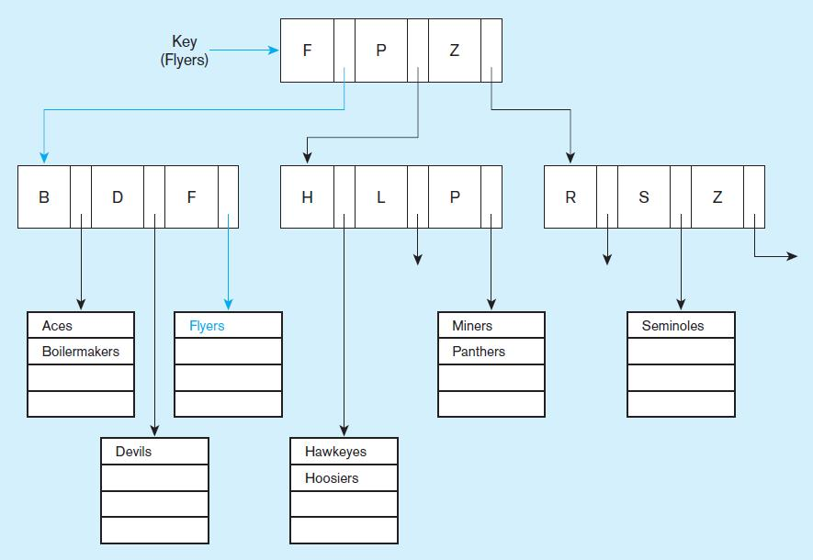
Figure 5-7b Indexed file organization
uses a tree search
Average time to find desired record = depth of the tree
Chapter 5
© 2013 Pearson Education, Inc. Publishing as Prentice Hall

Slide 30
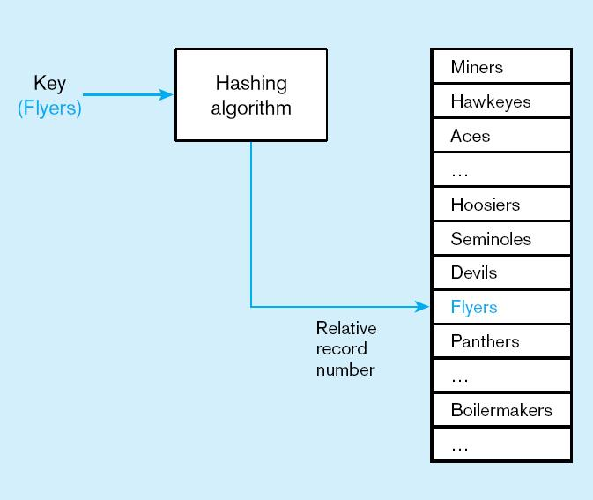
Figure 5-7c
Hashed file organization
Hash algorithm
Usually uses division-remainder to determine record position. Records with same position are grouped in lists.
Chapter 5
© 2013 Pearson Education, Inc. Publishing as Prentice Hall

Slide 31
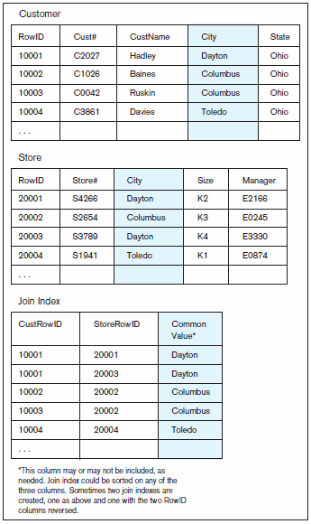
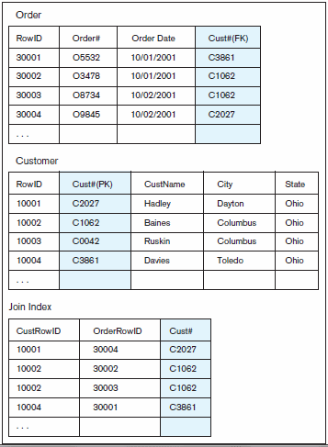
Figure 6-8 Join Indexes–speeds up join operations
b) Join index for matching foreign key (FK) and primary key (PK)
a) Join index for common non-key columns
Chapter 5
© 2013 Pearson Education, Inc. Publishing as Prentice Hall

Slide 32
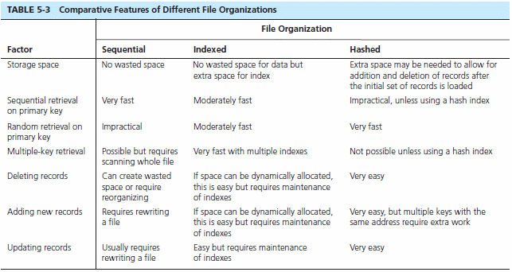
Chapter 5
© 2013 Pearson Education, Inc. Publishing as Prentice Hall

Slide 33
CLUSTERING FILES
In some relational DBMSs, related records from different tables can be stored together in the same disk area
Useful for improving performance of join operations
Primary key records of the main table are stored adjacent to associated foreign key records of the dependent table
e.g. Oracle has a CREATE CLUSTER command

Slide 34
RULES FOR USING INDEXES
Use on larger tables
Index the primary key of each table
Index search fields (fields frequently in WHERE clause)
Fields in SQL ORDER BY and GROUP BY commands
When there are >100 values but not when there are <30 values

Slide 35
RULES FOR USING INDEXES (CONT.)
Avoid use of indexes for fields with long values; perhaps compress values first
If key to index is used to determine location of record, use surrogate (like sequence number) to allow even spread in storage area
DBMS may have limit on number of indexes per table and number of bytes per indexed field(s)
Be careful of indexing attributes with null values; many DBMSs will not recognize null values in an index search

Slide 36

QUERY OPTIMIZATION
Parallel query processing–possible when working in multiprocessor systems
Overriding automatic query optimization–allows for query writers to preempt the automated optimization
Oracle example:
    /* */ clause is a hint to override Oracle’s default query plan

Slide 37

Copyright © 2013 Pearson Education, Inc. Publishing as Prentice Hall

